Slide 1
Assignment 1 - Linear Regression
CS4287
17206413 - Eoin Gohery

Slide 2
Step 1: The Dataset
I am using a kaggle dataset detailing House Sales in King County, USA
My Neural network will be focusing on the prediction of house prices based on the data of 13 columns in the dataset.
Kaggle Link: https://www.kaggle.com/harlfoxem/housesalesprediction.
Note: Other Datasets were used in experimentation but proved incompatible for a Linear Regression based neural network

Slide 3
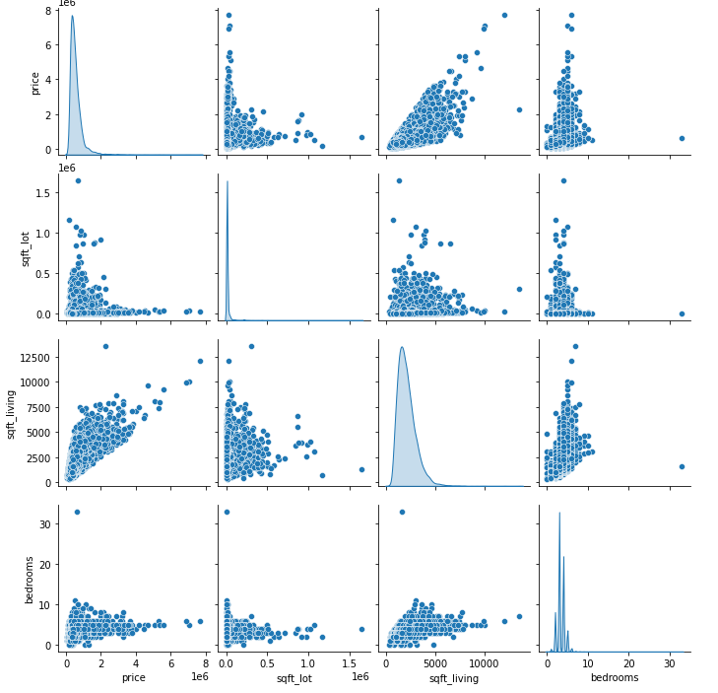
Dataset Breakdown
Key Columns

Slide 4
Step 2: Environment
I chose to use Google Colab for this project for the following reasons:
The added processing power of Colab.
Ability to run sections of code separately
Easily view data as it changes.
High compatibility with Tensorflow as both are Google systems.
Jupyter can be used for the same reasons.
I will also be using the Keras Library to simplify the model design process as Kears is simply a wrapper of Tensorflow
Upon completion in google colab the project will exported as a .py file and tested on my local machine within a python environment to ensure the neural network runs without issue outside of Google Colab.

Slide 5
Step 3: Initialisation
First I added my imports.
Panda for data reading/manipulation.
Numpy for Output Normalisation.
Seaborn to visualise data.
Sklearn for preprocessing and train_test_split.
Keras for Dense and Sequential (Model Setup).
Matplotlib.pyplot to plot my loss graph at the end.
Each import was added as the project developed.
Others were originally used but replaced for these final versions e.g numpy was first used for the data array but proved to be less intuitive for use with a csv.

Slide 6
Step 4: Read Data
To allow the data to be read from the web, i copied the kc_house_data.csv file from kaggle to a github repository.
Raw Github URL: https://raw.githubusercontent.com/EoinGohery/LinearRegression/main/kc_house_data.csv
While reading the data I specified “engine='python', error_bad_lines=False, sep=','”. This was to ensure that the data imported with no errors (skipping any lines that cause issues) and correctly formatted for ‘ , ‘ delimiters.
The input Data was then normalised using the min_max_scaler.
Note: The output data was normalised as well but the results with normalised output were less defined.

Slide 7
Step 5: Prep Data
First the data was split into X (inputs) and Y (output) values.
I used the .iloc command on the rawData and specified .values after to allow for the panda dataframe to be read correctly
The input data ‘X’ was then normalised using the min_max_scaler so that all values would be between 0 (lowest value) and 1 (highest value). This was done as Regression algorithms can often be broken by unbounded inputs.
Finally the data was split into the necessary variables using train_test_split. First, split as a 70% train and 30% test_and_val. Test_and_split was then split 15% as test and 15% as val.
Note: Values indicated on the left represent % of total Dataset
X_train (70%)
X_val (15%)
X_test (15%)
Y_train (70%)
Y_val (15%)
Y_test (15%)

Slide 8
Step 6: Model Setup
For the model I chose to use a 3 layer neural network design. 2 hidden layers and 1 output layer. My model included 14 inputs.
The hidden layers are using relu activation:
64 neurons
32 neurons
The output layer is using linear activation. After testing this activation proved most promising when compared to sigmuid or relu.

Slide 9
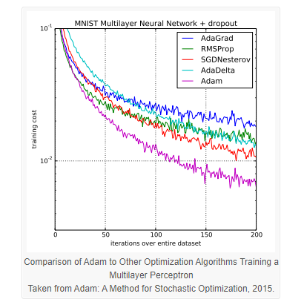
Step 7: Optimisation
For the Optimiser, I chose to use Adam. This decision was partially based on research found online comparing adam with other optimisers.
But primarily, Adam was chosen after using multiple optimisers were tested including a custom SDG with varying learning rates and momentum.
Similarly, for the Loss algorithm I simply chose the regression algorithm which provided the most favorable results. In this case is used the ‘mean_squared_logarithmic_error’

Slide 10
Step 8: Training
For Training the network is implemented with the following data.
batch_size=64
epochs=50
These figures were chosen based on test results and provide consistent and results at a low loss.
The training data and validation data is specified in the previous slide for “Prep Data”

Slide 11
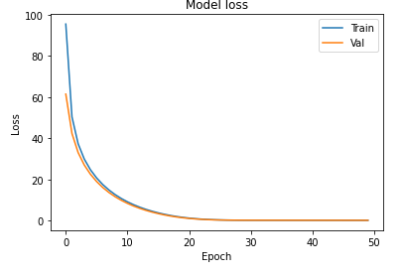
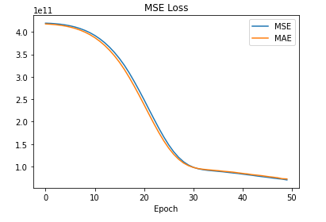
Step 9: Display Graph
This is a simple step and while having no impact on the performance of the network, is vital for reviewing training data.
This graph simply plots loss value as it correlates to the No. Epochs performed. I.e. This graph plots the improvement of the neural network over time
On the left is the graph using the mean squared logarithmic error Loss function
On the right is the graph using the mean squared error metric

Slide 12
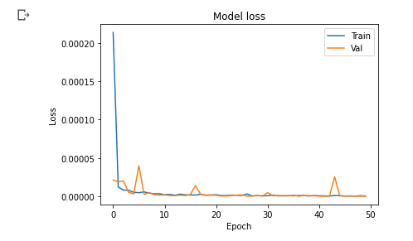
Performance
Initial Epoch:
Final Epoch (50):
Final using a normalised output:

